Slide 1
Intermediate SQL
Prof. X

Slide 2
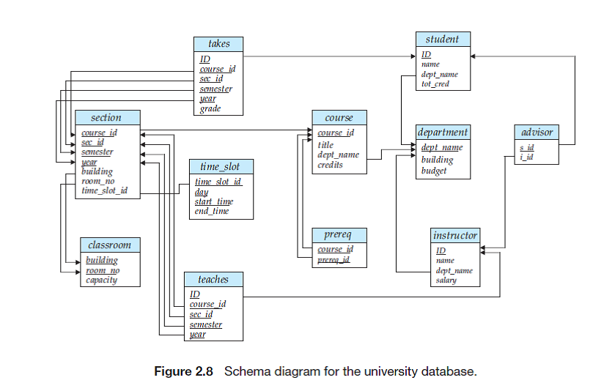
University Example Used Here

Slide 3
Nested Subqueries
SQL provides a mechanism for the nesting of subqueries. A subquery is a select-from-where expression that is nested within another query.
The nesting can be done in the following SQL query select A₁, A₂, ..., A_{n} from r₁, r₂, ..., r_{m} where P
as follows:
From clause: r_{i} can be replaced by any valid subquery
Where clause: P can be replaced with an expression of the form:
B <operation> (subquery)
B is an attribute and <operation> to be defined later.
Select clause:
A_{i} can be replaced by a subquery that generates a single value.

Slide 4
Set Membership
Operation: in
For example, 5 is in the set {1, 2, 3, 4, 5}
Operation: not in
For example, 6 is not in the set {1, 2, 3, 4, 5}

Slide 5
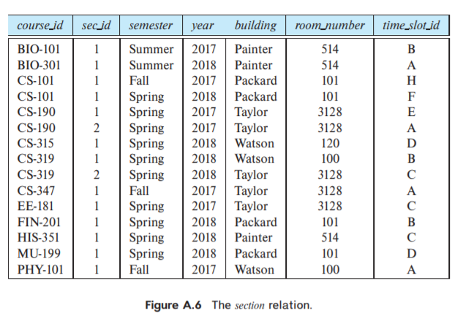
Set Membership
Find courses offered in Fall 2017 and in Spring 2018
select distinct course_id
from section
where semester = 'Fall' and year= 2017 and course_id in (select course_id
from section
where semester = 'Spring' and year= 2018);
Find courses offered in Fall 2017 but not in Spring 2018
select distinct course_id
from section
where semester = 'Fall' and year= 2017 and course_id not in (select course_id
from section
where semester = 'Spring' and year= 2018);

Slide 6
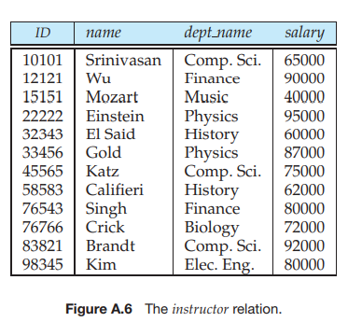
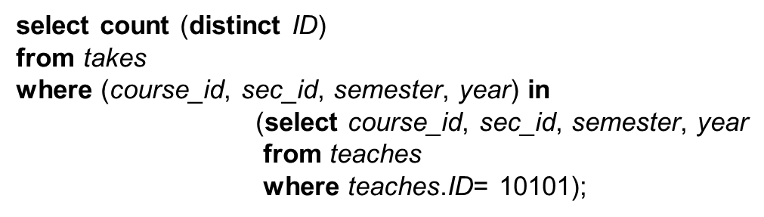
Set Membership (Cont.)
Name all instructors whose name is neither “Mozart” nor “Einstein”
select distinct name
from instructor
where name not in ('Mozart', 'Einstein')
Find the total number of (distinct) students who have taken course sections taught by the instructor with ID 10101
Note: Above query can be written in a much simpler manner. The formulation above is simply to illustrate SQL features

Slide 7
Set Comparison
Operation: some
For example, 3 > some {1, 2, 3, 4, 5}
4 < some {1, 2, 3, 4, 5}
Operation: all
For example, 6 > all {1, 2, 3, 4, 5}
Operation: exists
Return true if set is not empty
Otherwise, return false
Operation: not exists
Return true if set is empty
Otherwise, return false

Slide 8
Set Comparison – “some” Clause
Find names of instructors with salary greater than that of some (at least one) instructor in the Biology department.
select distinct T.name
from instructor as T, instructor as S
where T.salary > S.salary and S.dept name = 'Biology';
Same query using > some clause
select name
from instructor
where salary > some (select salary
from instructor
where dept name = 'Biology');

Slide 9
Definition of “some” Clause
0
(5 < some
5
) = true
(read: 5 < some tuple in the relation)
6
0
(5 < some
5
) = false
0
(5 = some
) = true
5
0
(5 ≠ some
5
) = true (since 0 ≠ 5)
(= some) ≡ in
However, (≠ some) ≡ not in

Slide 10
Set Comparison – “all” Clause
Find the names of all instructors whose salary is greater than the salary of all instructors in the Biology department.
select name
from instructor
where salary > all (select salary
from instructor
where dept name = 'Biology');

Slide 11
Definition of “all” Clause
0
(5 < all
5
) = false
6
6
(5 < all
) = true
10
4
(5 = all
) = false
5
4
(5 ≠ all
) = true (since 5 ≠ 4 and 5 ≠ 6)
6
(≠ all) ≡ not in
However, (= all) ≡ in

Slide 12
Test for Empty Relations
The exists construct returns the value true if the argument subquery is nonempty.
exists r ⇔ r ≠ Ø
not exists r ⇔ r = Ø

Slide 13
Use of “exists” Clause
Yet another way of specifying the query “Find all courses taught in both the Fall 2017 semester and in the Spring 2018 semester”
select course_id from section as S where semester = 'Fall' and year = 2017 and exists (select * from section as T where semester = 'Spring' and year= 2018 and S.course_id = T.course_id);
Correlation name – variable S in the outer query
Correlated subquery – the inner query

Slide 14
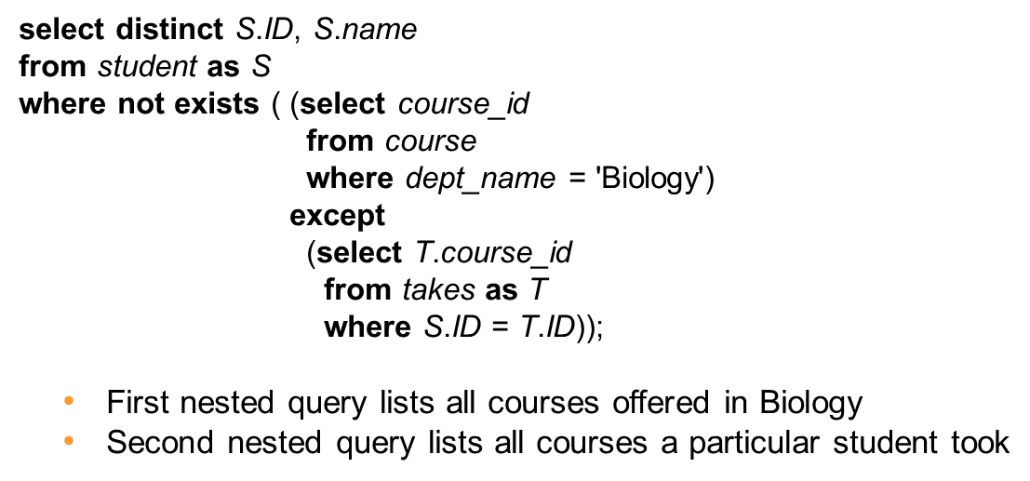
Use of “not exists” Clause
Find all students who have taken all courses offered in the Biology department.
Note that X – Y = Ø ⇔ X ⊆ Y
Note: Cannot write this query using = all and its variants

Slide 15
Test for Absence of Duplicate Tuples
The unique construct tests whether a subquery has any duplicate tuples in its result.
The unique construct evaluates to “true” if a given subquery contains no duplicates .
Find all courses that were offered at most once in 2017
select T.course_id from course as T where unique ( select R.course_id from section as R where T.course_id= R.course_id and R.year = 2017);

Slide 16
Subqueries in the From Clause

Slide 17
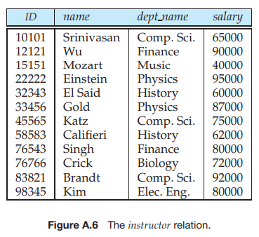
Subqueries in the Form Clause
SQL allows a subquery expression to be used in the from clause
Find the average instructors’ salaries of those departments where the average salary is greater than $42,000.”
select dept_name, avg_salary from ( select dept_name, avg (salary) as avg_salary from instructor group by dept_name) where avg_salary > 42000;
Note that we do not need to use the having clause
Another way to write above query
select dept_name, avg_salary from ( select dept_name, avg (salary) from instructor group by dept_name)
as dept_avg (dept_name, avg_salary)
where avg_salary > 42000;

Slide 18
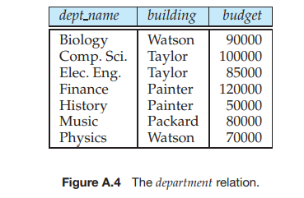
With Clause
The with clause provides a way of defining a temporary relation whose definition is available only to the query in which the with clause occurs.
Find all departments with the maximum budget with max_budget (value) as (select max(budget) from department) select department.name from department, max_budget where department.budget = max_budget.value;

Slide 19
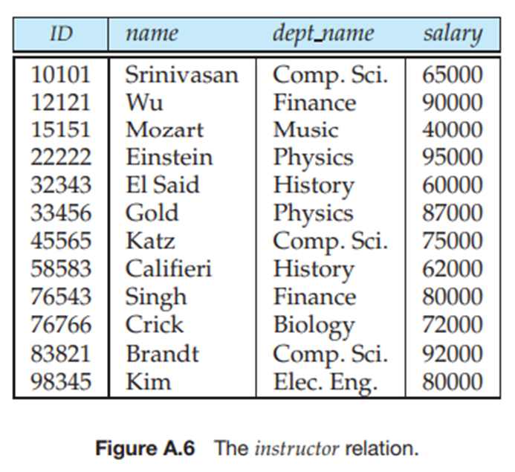
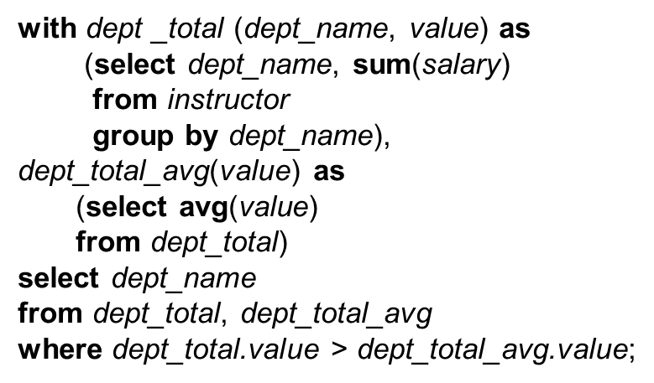
Complex Queries using With Clause
Find all departments where the total salary is greater than the average of the total salary at all departments

Slide 20
Scalar Subquery
Scalar subquery is one which is used where a single value is expected
List all departments along with the number of instructors in each department
select dept_name, ( select count(*) from instructor where department.dept_name = instructor.dept_name) as num_instructors from department;
Runtime error if the subquery is in the select clause and the subquery returns more than one result tuple

Slide 21
View
In some cases, it is not desirable for all users to see the entire logical model (that is, all the actual relations stored in the database.)
Consider a person who needs to know an instructors name and department, but not the salary. This person should see a relation described, in SQL, by select ID, name, dept_name from instructor
A view provides a mechanism to hide certain data from the view of certain users.
Any relation that is not of the conceptual model but is made visible to a user as a “virtual relation” is called a view.

Slide 22
View Definition
A view is defined using the create view statement which has the form
create view v_name as < query expression >
where <query expression> is any legal SQL expression. The view name is represented by v_name.
Once a view is defined, the view name can be used to refer to the virtual relation that the view generates.
View definition is not the same as creating a new relation by evaluating the query expression
Rather, a view definition causes the saving of an expression; the expression is substituted into queries using the view.

Slide 23
View Definition and Use
A view of instructors without their salary
create view faculty as select ID, name, dept_name from instructor
Find all instructors in the Biology department
select name from faculty where dept_name = 'Biology'
Create a view of department salary totals
create view departments_total_salary(dept_name, total_salary) as select dept_name, sum (salary) from instructor group by dept_name;

Slide 24
Views Defined Using Other Views
create view physics_fall_2017 as select course.course_id, sec_id, building, room_number from course, section where course.course_id = section.course_id and course.dept_name = 'Physics' and section.semester = 'Fall' and section.year = '2017’;
create view physics_fall_2017_watson as select course_id, room_number from physics_fall_2017 where building= 'Watson';

Slide 25
View Expansion
Expand the view :
create view physics_fall_2017_watson as select course_id, room_number from physics_fall_2017 where building= 'Watson'
To:
create view physics_fall_2017_watson as
select course_id, room_number
from (select course.course_id, building, room_number
from course, section
where course.course_id = section.course_id
and course.dept_name = 'Physics'
and section.semester = 'Fall'
and section.year = '2017')
where building= 'Watson';

Slide 26
Materialized Views
Certain database systems allow view relations to be physically stored.
Physical copy created when the view is defined.
Such views are called Materialized view:
If relations used in the query are updated, the materialized view result becomes out of date
Need to maintain the view, by updating the view whenever the underlying relations are updated.

Slide 27
Update of a View
Add a new tuple to faculty view which we defined earlier
insert into faculty
values ('30765', 'Green', 'Music');
This insertion must be represented by the insertion into the instructor relation
Must have a value for salary.
Two approaches
Reject the insert
Inset the tuple
('30765', 'Green', 'Music', null)
into the instructor relation

Slide 28
Some Updates Cannot be Translated Uniquely
create view instructor_info as select ID, name, building from instructor, department where instructor.dept_name= department.dept_name;
insert into instructor_info
values ('69987', 'White', 'Taylor');
Issues
Which department, if multiple departments in Taylor?
What if no department is in Taylor?

Slide 29
And Some Not at All
create view history_instructors as select * from instructor where dept_name= 'History';
What happens if we insert
('25566', 'Brown', 'Biology', 100000)
into history_instructors?

Slide 30
View Updates in SQL
Most SQL implementations allow updates only on simple views
The from clause has only one database relation.
The select clause contains only attribute names of the relation, and does not have any expressions, aggregates, or distinct specification.
Any attribute not listed in the select clause can be set to null
The query does not have a group by or having clause.

Slide 31
Modification of the Database
Deletion of tuples from a given relation.
Insertion of new tuples into a given relation
Updating of values in some tuples in a given relation

Slide 32
Deletion
Delete all instructors
delete from instructor
Delete all instructors from the Finance department delete from instructor where dept_name= 'Finance’;
Delete all tuples in the instructor relation for those instructors associated with a department located in the Watson building.
delete from instructor where dept name in (select dept name from department where building = 'Watson');

Slide 33
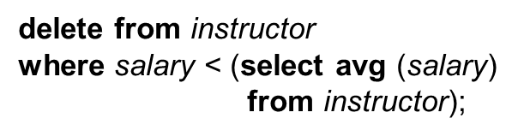
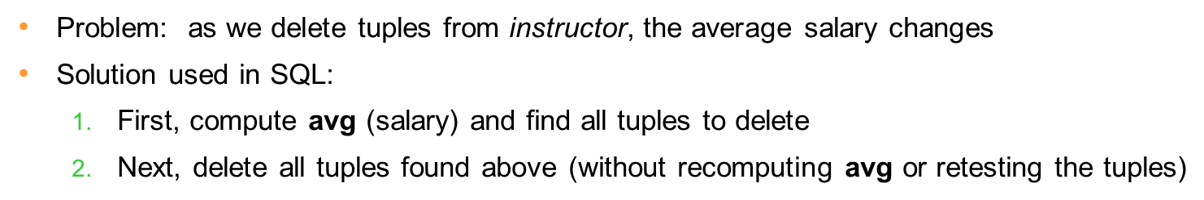
Deletion (Cont.)
Delete all instructors whose salary is less than the average salary of instructors

Slide 34
Insertion
Add a new tuple to course
insert into course values ('CS-437', 'Database Systems', 'Comp. Sci.', 4);
or equivalently
insert into course (course_id, title, dept_name, credits) values ('CS-437', 'Database Systems', 'Comp. Sci.', 4);
Add a new tuple to student with tot_creds set to null
insert into student values ('3003', 'Green', 'Finance', null);

Slide 35
Insertion (Cont.)
Make each student in the Music department who has earned more than 144 credit hours an instructor in the Music department with a salary of $18,000.
insert into instructor select ID, name, dept_name, 18000 from student where dept_name = 'Music' and total_cred > 144;
The select from where statement is evaluated fully before any of its results are inserted into the relation.
Otherwise queries like
insert into table1 select * from table1
would cause problem

Slide 36
Updates
Give a 5% salary raise to all instructors
update instructor set salary = salary * 1.05
Give a 5% salary raise to those instructors who earn less than 70000 update instructor set salary = salary * 1.05 where salary < 70000;
Give a 5% salary raise to instructors whose salary is less than average
update instructor set salary = salary * 1.05 where salary < (select avg (salary) from instructor);

Slide 37
Updates (Cont.)
Increase salaries of instructors whose salary is over $100,000 by 3%, and all others by a 5%
Write two update statements:
update instructor set salary = salary * 1.03 where salary > 100000; update instructor set salary = salary * 1.05 where salary <= 100000;
The order is important (Why)
Can be done better using the case statement (next slide)

Slide 38
Case Statement for Conditional Updates
Same query as before but with case statement
update instructor set salary = case when salary <= 100000 then salary * 1.05 else salary * 1.03 end

Slide 39
Updates with Scalar Subqueries
Recompute and update tot_creds value for all students
update student S set tot_cred = (select sum(credits) from takes, course where takes.course_id = course.course_id and S.ID= takes.ID.and takes.grade <> 'F' and takes.grade is not null);
Sets tot_creds to null for students who have not taken any course
Instead of sum(credits), use:
case when sum(credits) is not null then sum(credits) else 0 end

